Slide 1
Announcements
Lab 3 is graded
Next week is another night lab (meet here at 7:30 p.m. instead of 3:30 p.m.)
Check the schedule on Canvas for more details

Slide 2
Intro to the Night Sky

Slide 3
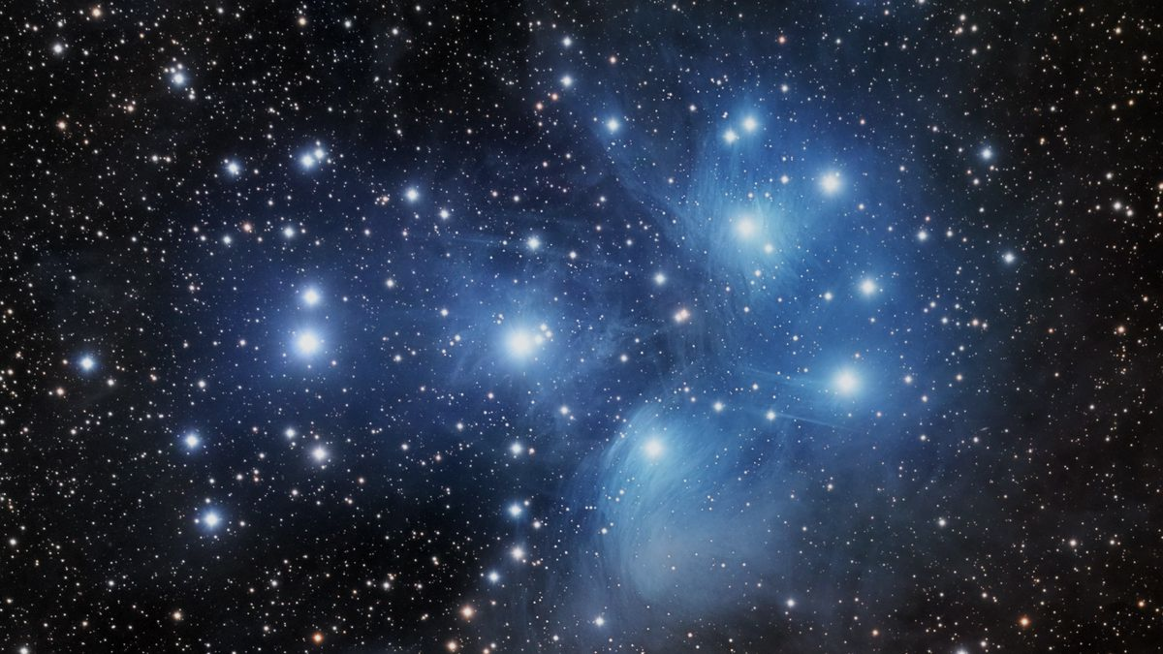
Introduction
This week we begin to explore the night sky
Observing in the night sky is recorded in the earliest parts of our history
We will focus on patterns that we see in the sky
Image Credit: https://www.space.com/pleiades.html
Pleiades - One of my favorites from a cultural astronomy perspective

Slide 4
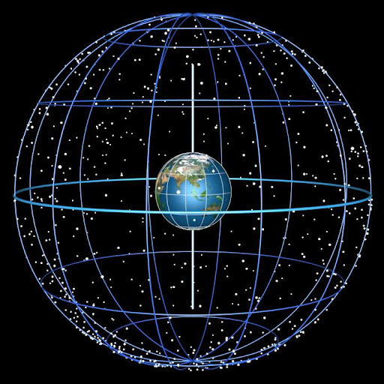
Celestial Sphere and North Pole
The night sky is like a sphere surrounding Earth this is called the Celestial Sphere
We can map things onto this sphere; think “angular size”
The North Celestial Pole (NCP) is the northern point where Earth’s axis of rotation intersects with the celestial sphere
The “North Star” (Polaris) is located very close to the NCP
Image Credit: https://utstronomy.wordpress.com/2019/02/04/the-celestial-sphere/

Slide 5
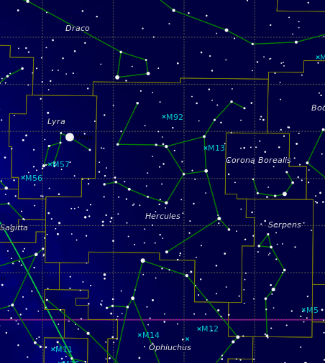
Constellations
Constellations = areas of sky where a group of stars form a recognizable pattern
The entire sky is broken up into 88 constellations
Every point in the sky is part of a constellation
If an object (Moon, planet) is in front of a constellation, it is within that constellation
Image Credit: https://in-the-sky.org/data/constellations_map.php

Slide 6
Special Constellations
Zodiacal Constellations are the set of 13 constellations that the Sun passes through in its apparent path through the sky each year
The 12 Zodiacal Constellations you may be familiar with are: Aries, Taurus, Gemini, Cancer, Leo, Virgo, Libra, Scorpius, Sagittarius, Capricornus, Aquarius, and Pisces
The 13th that you may not be familiar with is Ophiuchus (thanks Babylonians…)
The ecliptic is the apparent path of the sun in the sky throughout the year - you can find it on your star charts and star wheel!

Slide 7
Special Constellations Cont
Circumpolar Constellations are those which are close enough to the North Celestial Pole (NCP) that they do not set below the horizon
The number of circumpolar constellations is dependent on your location, specifically your latitude
In Tempe, our latitude is 33° - any object that is within 33° of the NCP will be circumpolar for us
Higher latitude means more circumpolar constellations
At the equator (latitude 0°), there are none, at the North Pole (latitude 90°), has the most
Circumpolar Constellations never set, meaning that they are “visible” all day and night! (But they do still rotate)
Also applies to the southern hemisphere (different constellations), but we are in the northern one so…
Notes:
It’s because those are the ones we can see from here

Slide 8
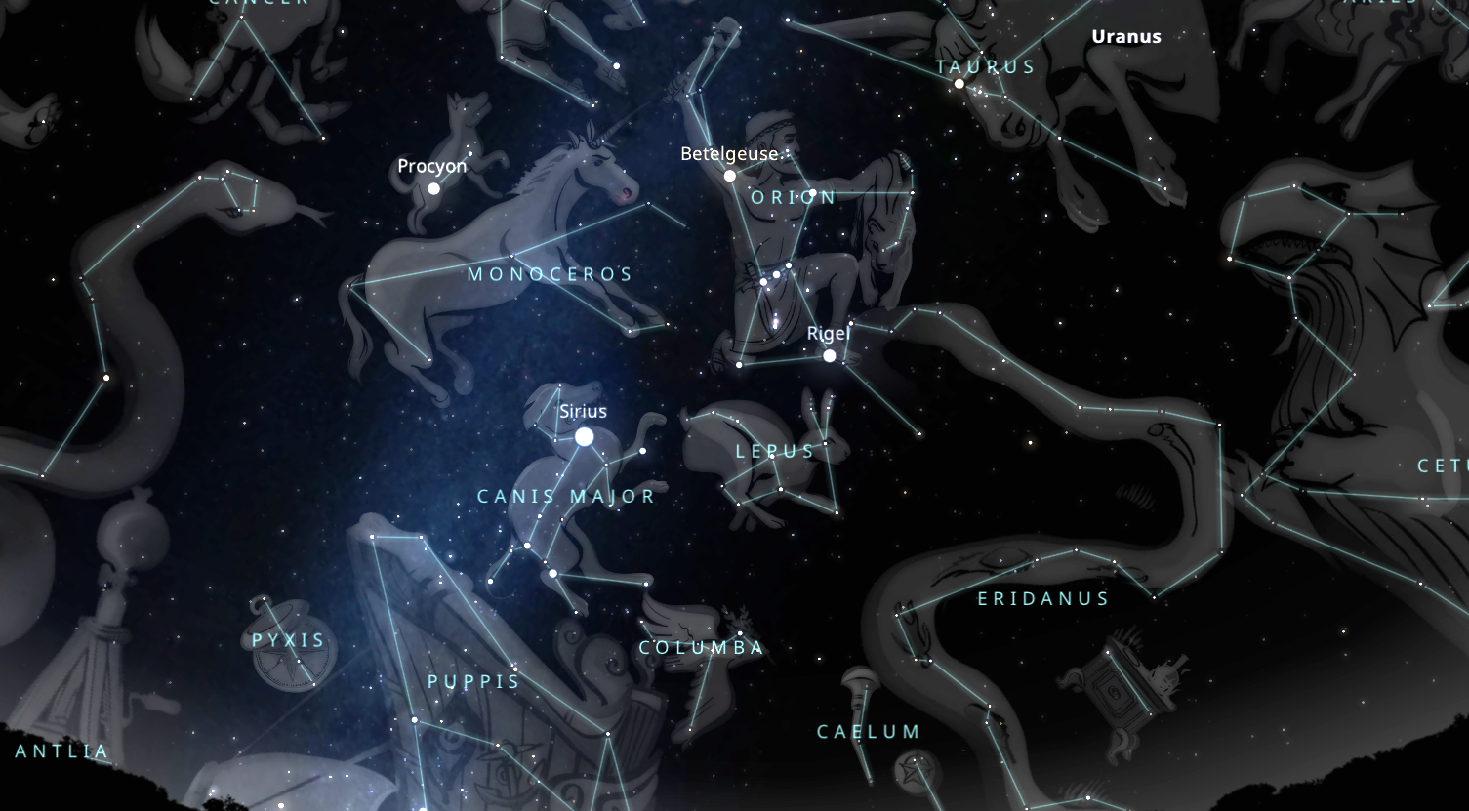
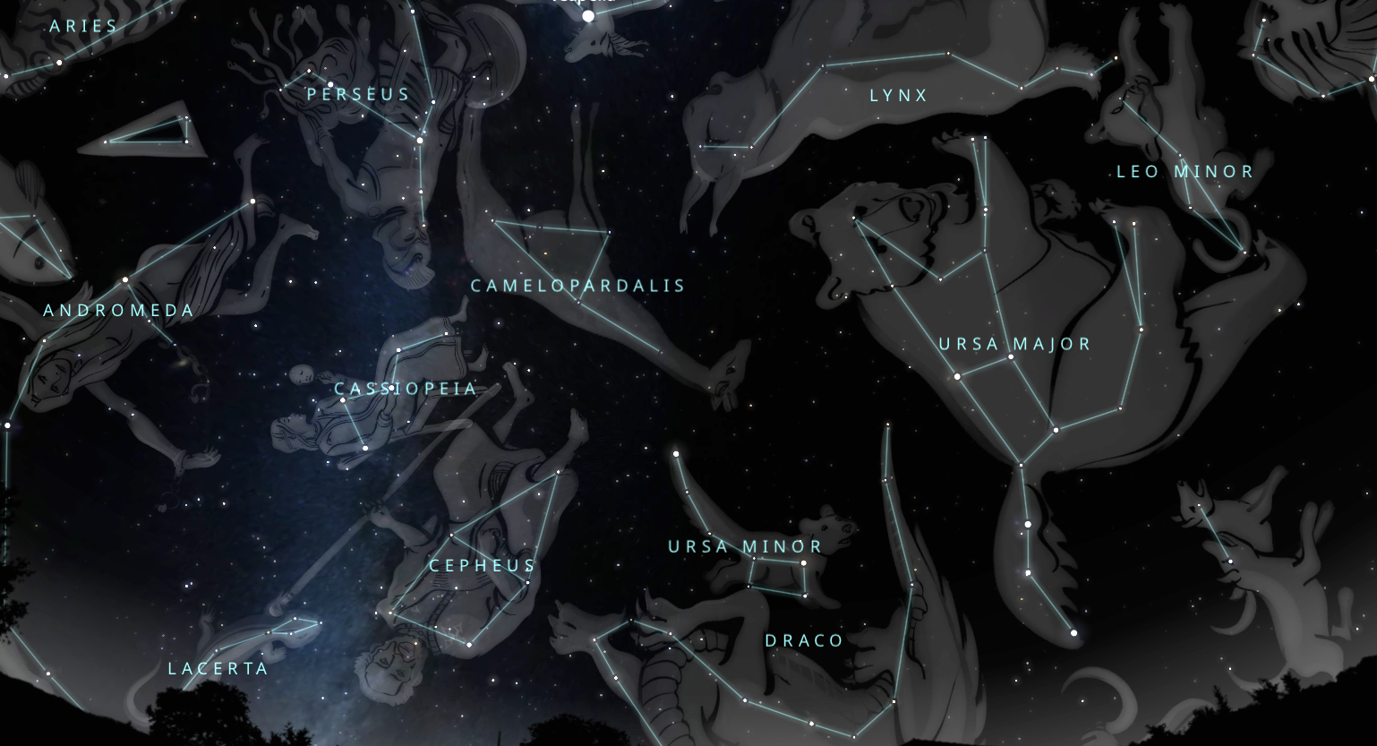
Asterisms (Patterns in the Sky)
Often we don’t point out entire constellations (remember, constellations are areas of the sky), instead:
Patterns within (or across) constellations
Prominent groups of stars
This is called an Asterism
Examples:
The Big Dipper (part of Ursa Major)
The Great Square of Pegasus
Technically… The patterns constellations are named for ARE asterisms, but not all asterisms are constellations…
Image Credits: Screenshots from https://stellarium-web.org/, edited by author; Stellarium set to Tempe, Az 21:16 Feb. 10 2026

Slide 9
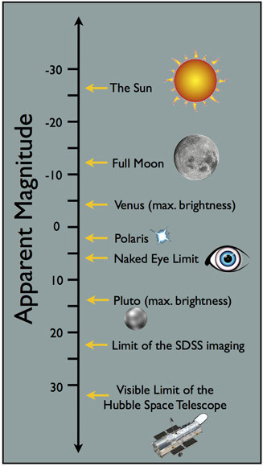
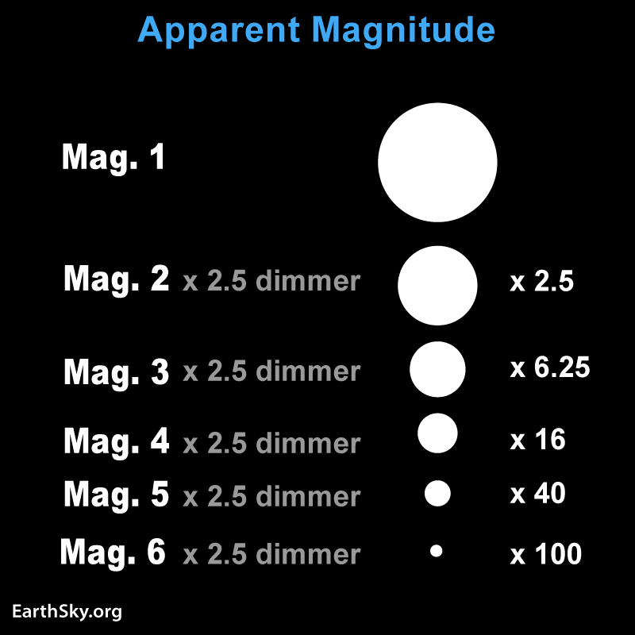
Magnitudes (More in future labs - Stellar Magnitude and H-R Diagrams)
Stars don’t look the same
Apparent Magnitude is how we describe a celestial object’s brightness
The smaller the magnitude, the brighter the object is
On star charts, etc, Magnitude is denoted by the size of the star in the illustration
The scale is logarithmic - a magnitude 1 star is ~2.5 times brighter than a magnitude 2 star
Image credits: https://earthsky.org/astronomy-essentials/what-is-stellar-magnitude/ (left) and https://voyages.sdss.org/preflight/light/magnitudes/ (right)

Slide 10
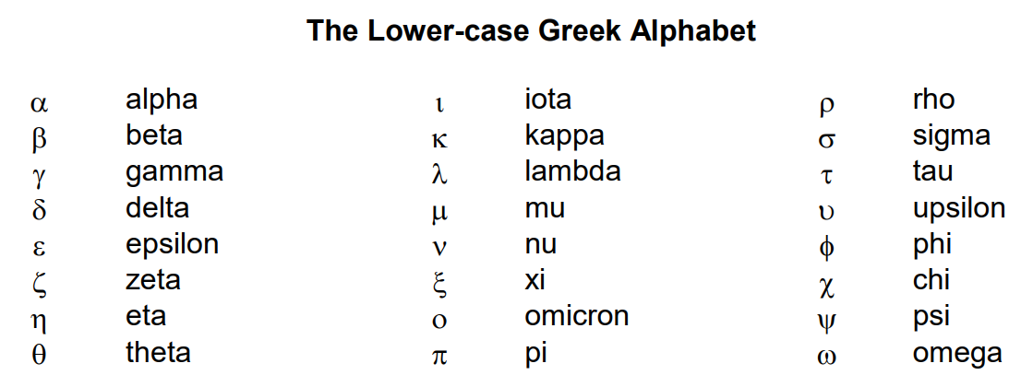
Stellar Nomenclature
Common names are names for the brightest stars (ex: Polaris, Vega, Betelgeuse)
The number of stars with common names has been increasing as the IAU has started to officially recognize star names from more cultures
Proper names consist of two parts: the name of the constellation the star is in and a Greek letter
The Greek Letter typically denotes the brightness like a rank: 𝝰 (alpha) is the brightest, ᵦ is the second brightest, etc. (exceptions exist) (*cough* Question 6 *cough*)

Slide 11
How to Use the Star Wheel
The star wheel is a tool to see what the sky will look like at a specific day and time of the year
Spin the wheel so that the date is aligned with the time (Feb 10/11, 8:00 PM)
It is like a map of the stars
The hole in the middle is Polaris (the North Star)

Slide 12
Today:
Do Questions 1-8 now
Then we will go to the roof for the rest of the lab
I have a couple Audubon Guides available to borrow for Questions 5-8
Page 561
But you can also use the Stellarium web or mobile app
Careful with Question 6
It’s an exception to the normal naming convention
After this, we will go to the roof

Slide 13
Stop! Roof Stuff After This

Slide 14
Roof Rules
Bring your stuff with you
We will not be coming back to the classroom
Do not leave the walled in area
Red flashlights only
No white lights except in emergencies
We will be up there with one or more other classes
You can ask me or the other TA(s) if you have any questions

Slide 15
Roof and Sketching Tips
Give your eyes time to adjust
Make an attempt at all sketches
I will not be grading you on artistic skill or precision
As long as you make a genuine attempt and I can tell what you were trying to do, while including the required objects, you will get full credit
Draw what you can see
Not what you think we want you to see
Some of you may have better eyesight and can see more stars than others - draw them
If you can’t, don’t
If a required object is blocked by a building or cloud - note that (or even draw said cloud/building)
Use the size of dots to represent brightness - the brighter an object, the bigger the dot
The bottom of the page is the horizon, and the top is straight overhead
Questions 9 and 10: Can also use your star wheel or Stellarium for this information

Slide 16
Required Objects in sketches and tables
Constellation Sketch:
Orion
Table 1:
Sirius, Betelgeuse, Rigel, Polaris, Castor, and Pollux
Table 2:
Jupiter and maybe Saturn*
Northern Sky Sketch:
At least: Polaris, Ursa Minor, Cassiopea, maybe Ursa Major*
Southern Sky Sketch:
At least: Orion, Taurus, Canis Major*, Canis Minor
If you can see more, draw more
*May be blocked by a building

